Slide 1

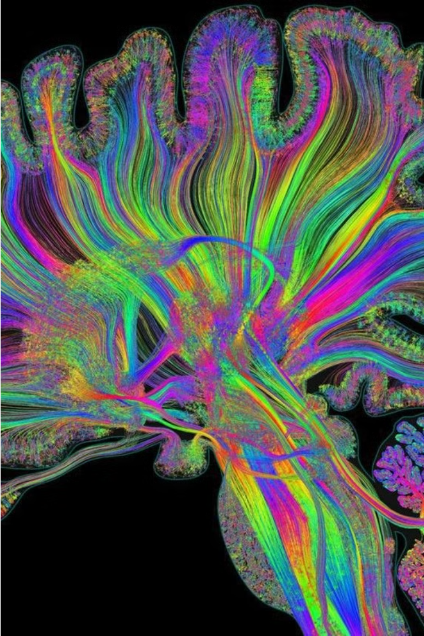

Brain Tumor Detection Using Computer Vision
Leveraging advanced computer vision techniques to revolutionize early brain tumor diagnosis and treatment.
by Shalini Galingula

Slide 2
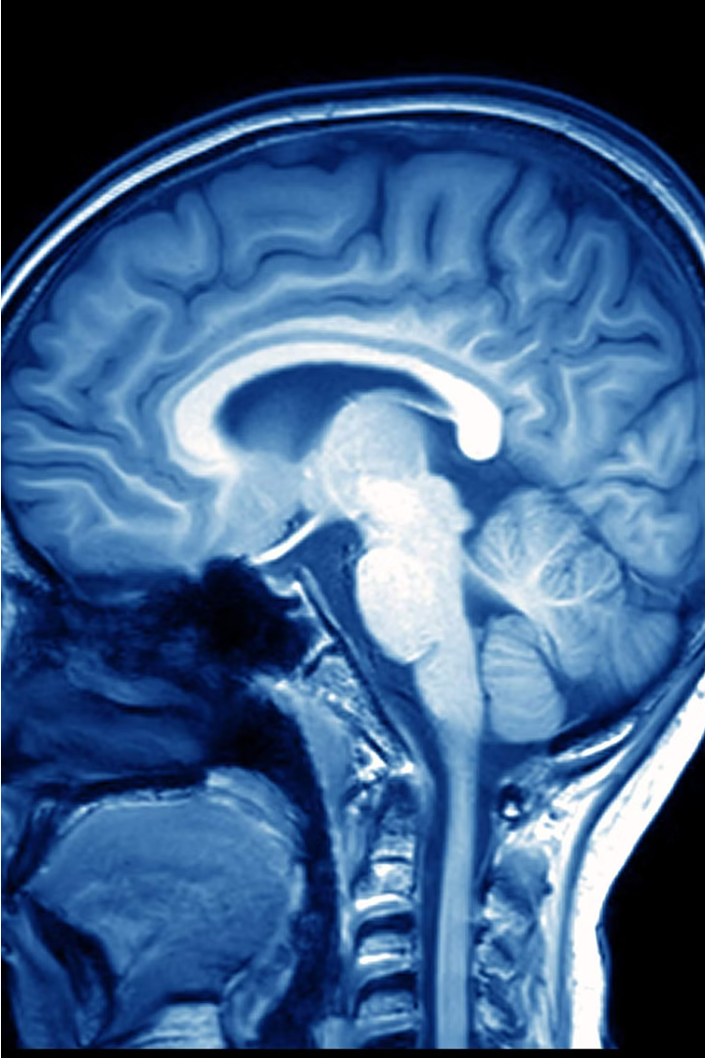
Introduction
This presentation will explore the use of computer vision techniques to detect and diagnose brain tumors from medical imaging data. We will examine the importance of early detection, the key software and libraries required, and the process of preparing and analyzing the brain MRI dataset.

Slide 3
Overview of Brain Tumors and Their Impact
High Prevalence
Diverse Types
Brain tumors affect thousands of people worldwide, with an estimated incidence of 6 to 10 per 100,000 in the general population.
Brain tumors can be either benign or malignant, and can originate from various cell types within the brain tissue.
Debilitating Effects
High Mortality Rates
Brain tumors can cause a wide range of symptoms, including headaches, seizures, vision problems, and cognitive impairment, significantly impacting a patient's quality of life.
Brain tumors are a leading cause of cancer-related deaths, with an overall 5-year survival rate of only 36%.

Slide 4
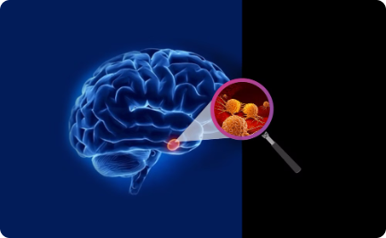

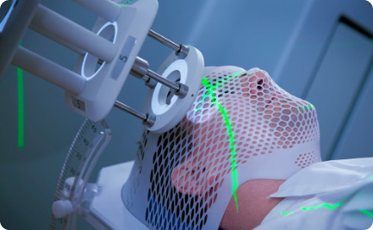
Importance of Early Detection
Improved Treatment Options
Increased Survival Rates
Less Invasive Procedures
Early detection of brain tumors significantly increases the chances of successful treatment and better outcomes for patients.
Catching brain tumors in their early stages can dramatically improve survival rates, giving patients a better chance at long-term recovery.
With early detection, doctors can often treat brain tumors using less invasive surgical techniques, reducing recovery times and complications.

Slide 5
Role of Computer Vision in Medical Imaging Analysis
Automated Detection
Improved Accuracy
Streamlined Workflows
Personalized Medicine
Computer vision algorithms can analyze medical images, such as X-rays and MRIs, to automatically detect abnormalities and potential signs of disease, aiding in early diagnosis.
By leveraging advanced image processing techniques, computer vision can identify subtle patterns and features in medical scans that may be overlooked by the human eye, leading to more accurate and consistent diagnoses.
Integrating computer vision into medical imaging analysis can help streamline workflows, reducing the time and effort required for radiologists and clinicians to review and interpret test results.
Computer vision can also support personalized treatment plans by analyzing individual patient data and identifying unique characteristics or abnormalities that may require tailored interventions.

Slide 6
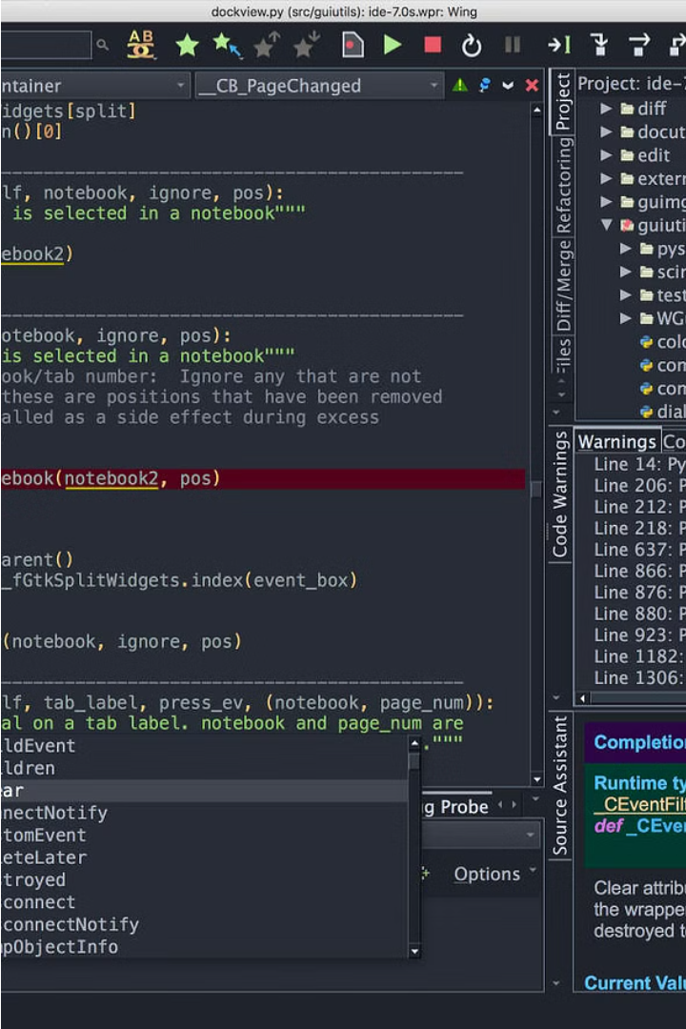
Requirements
The key software and libraries needed for the brain tumor detection project using computer vision are Python, scikit-learn, OpenCV, NumPy, and Matplotlib. These tools provide the necessary functionality for data preprocessing, model training, image analysis, and visualization.

Slide 7
Requirements
1
Python
2
Scikit-learn
The primary programming language used for the brain tumor detection project.
A powerful machine learning library for data preprocessing, model training, and evaluation.
3
OpenCV
4
NumPy and Matplotlib
A comprehensive computer vision and image processing library for tasks like image segmentation and feature extraction.
Numerical computing and data visualization libraries essential for scientific computing and image analysis.

Slide 8

Data Preparation
Preparing the dataset is a crucial step in the brain tumor detection process using computer vision. This involves loading the brain MRI images, applying preprocessing techniques, and organizing the data for subsequent analysis and model training.

Slide 9
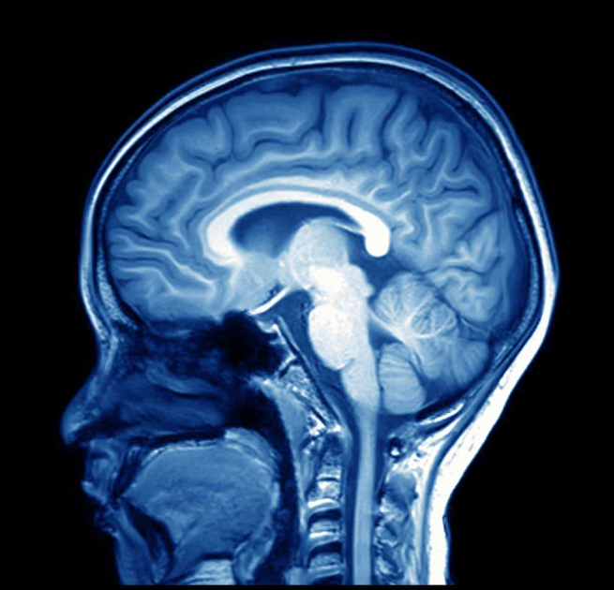
Explain the dataset used (brain MRI images)
The dataset used for this brain tumor detection project consists of high-resolution Magnetic Resonance Imaging (MRI) scans of human brains. The MRI images cover a diverse range of brain tumor types and stages, providing a comprehensive dataset for training and evaluating the computer vision models.

Slide 10



Data Preparation
Load MRI data
1
Import brain MRI image files into the project.
Pre-process images
2
Apply image normalization, resizing, and other preprocessing steps.
Split data
3
Divide the dataset into training, validation, and testing subsets.
The first step in the brain tumor detection pipeline is to load the dataset of brain MRI images. These images need to be preprocessed by normalizing pixel values, resizing to a consistent resolution, and potentially applying other image augmentation techniques. Finally, the dataset is split into training, validation, and testing subsets to evaluate model performance.

Slide 11


